Slide 1
Hospital Data Analytics Project
Name : A. Durga Bhavani
Domain: Healthcare Analytics
Tools: Python, Pandas, NumPy, Matplotlib

Slide 2
Problem Statement
Hospital data contains missing values, inconsistent records, and invalid entries
Difficult to analyze revenue, patient trends, and doctor performance
Objective is to clean data and extract meaningful insights for decision-making

Slide 3
Dataset Overview
30,000 hospital records and 21 columns are there.
Column names are:
patient_id doctor_name
patient_name treatment_type
age treatement_cost
gender insurance_coverage
city Billing_amount
admission_date Payment_status
discharge_date Admission_type
department length_of_stay
doctor_id

Slide 4
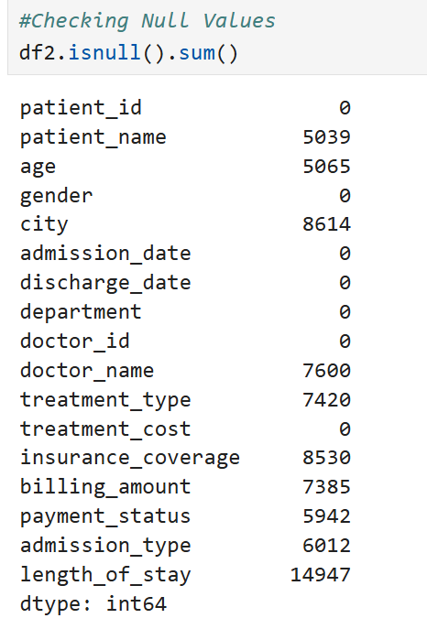
Data Issues
Missing values in :
Patient_name, city, doctor_name, treatment_type.
Age, billing_amount, Insurance_coverage
Payment_status, Admission_type, length_of_stay
Invalid Data:
Negative age values
Negative length_of_stay
Wrong Gender Allocation
Inconsistent formats:
Mixed date formats
Mixed case in categorical values

Slide 5
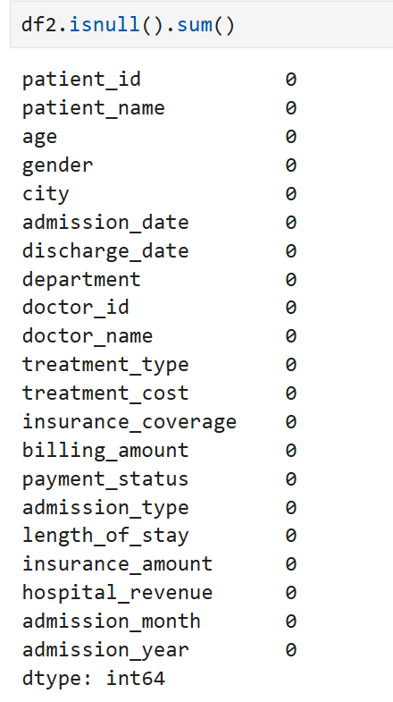
Cleaning Approach
Data Standardization
Text columns (gender, city, names)
Date columns(Admission_date, Discharge_date)
Handled missing values using:
Unknown( for names)
Mode (categorical)
Median (numeric)
Group-based imputation
Fixed invalid age values
Corrected date formats
Corrected Gender Values
Derived new features:
length_of_stay
insurance_amount
hospital_revenue

Slide 6
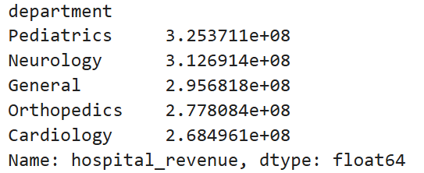
Analysis
# Revenue by department
df2.groupby('department')['hospital_revenue'].sum().sort_values(ascending=False)
Output:

Slide 7
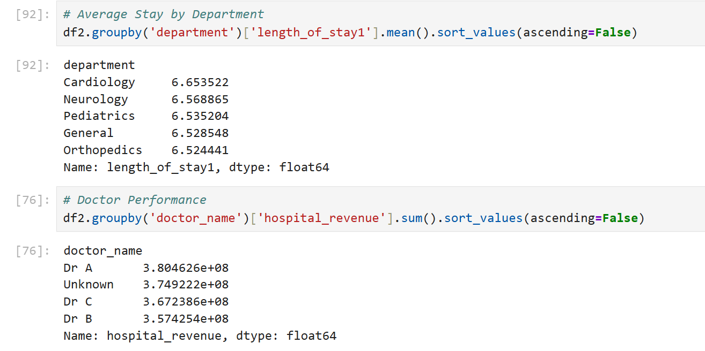

Slide 8
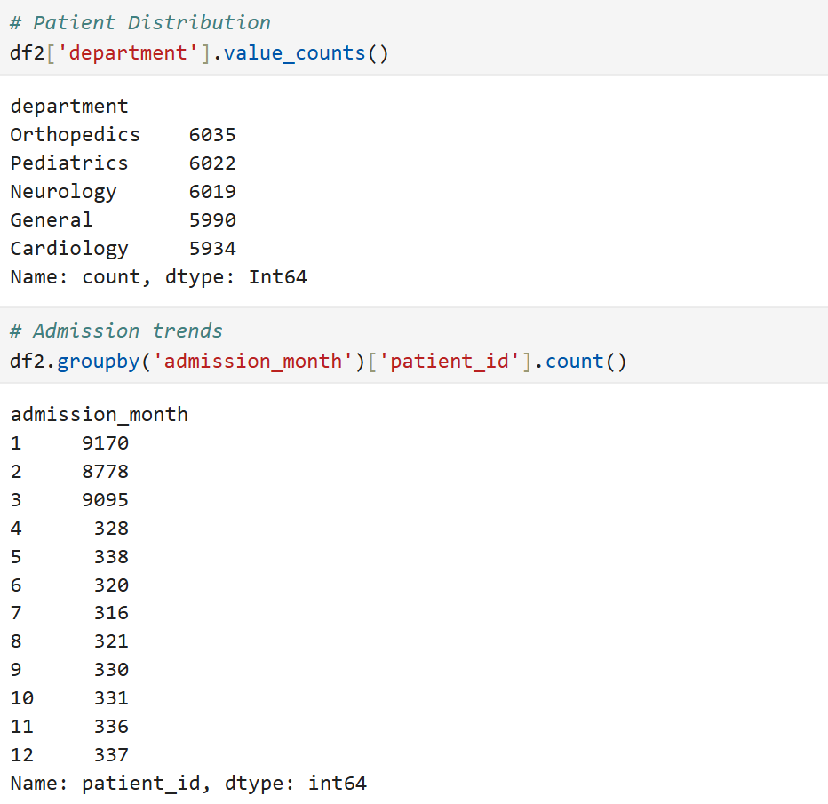

Slide 9
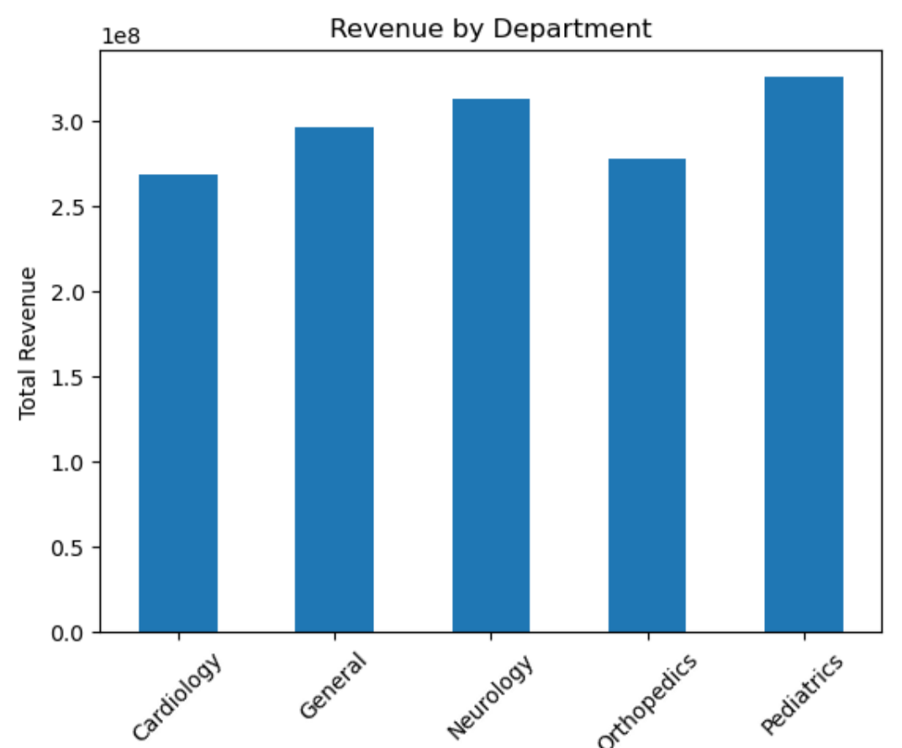
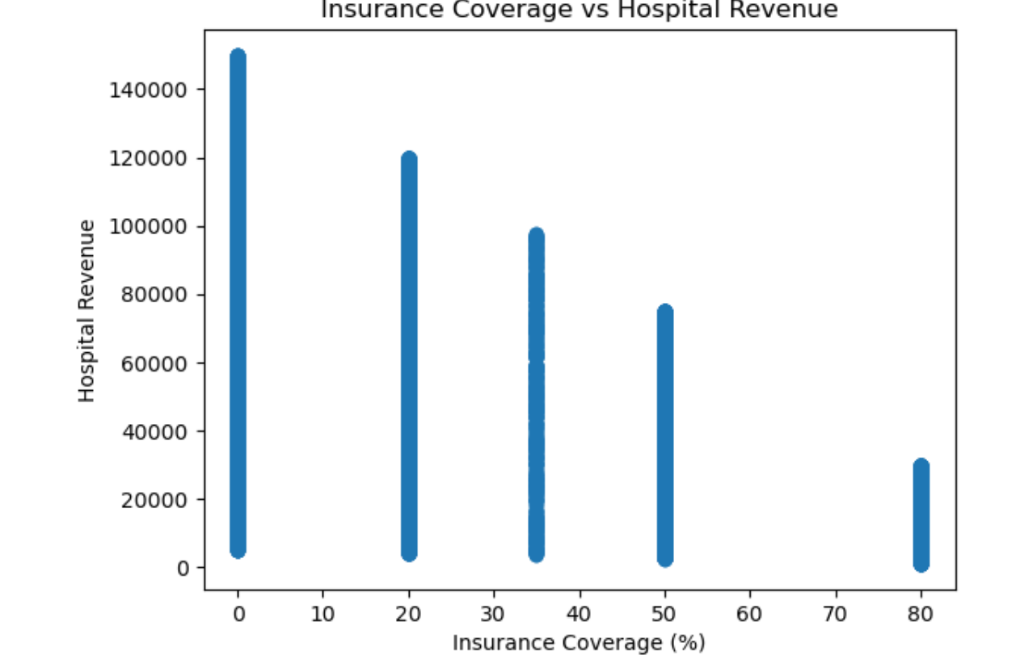
Insights
Revenue by Department
(pediatrics generates
highest revenue)
Insurance vs Hospital Revenue
(High insurance reduces
hospital revenue)

Slide 10
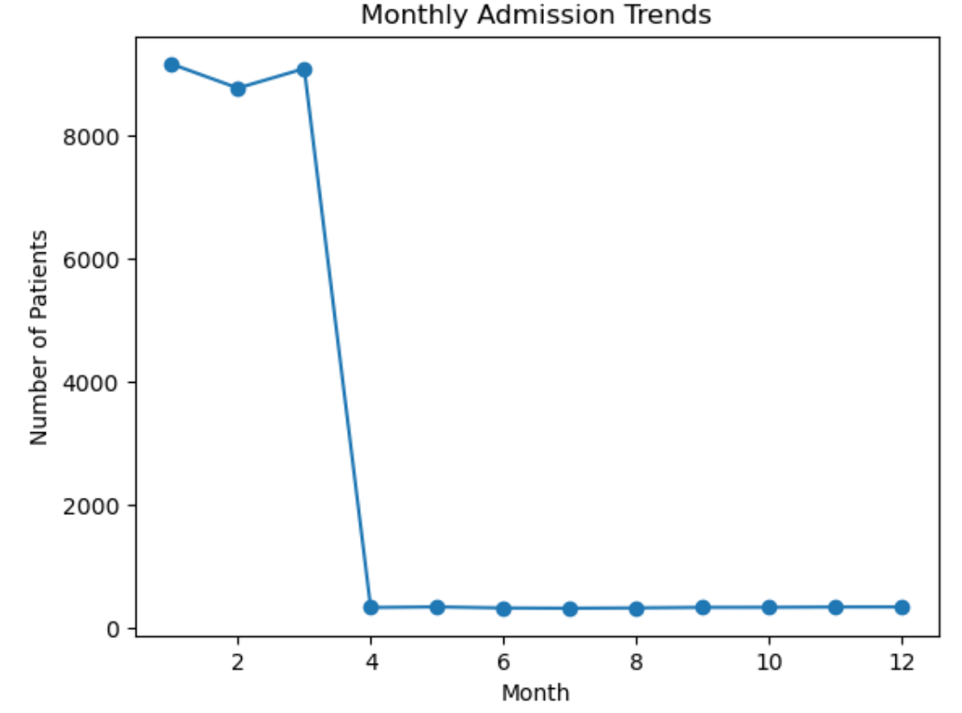
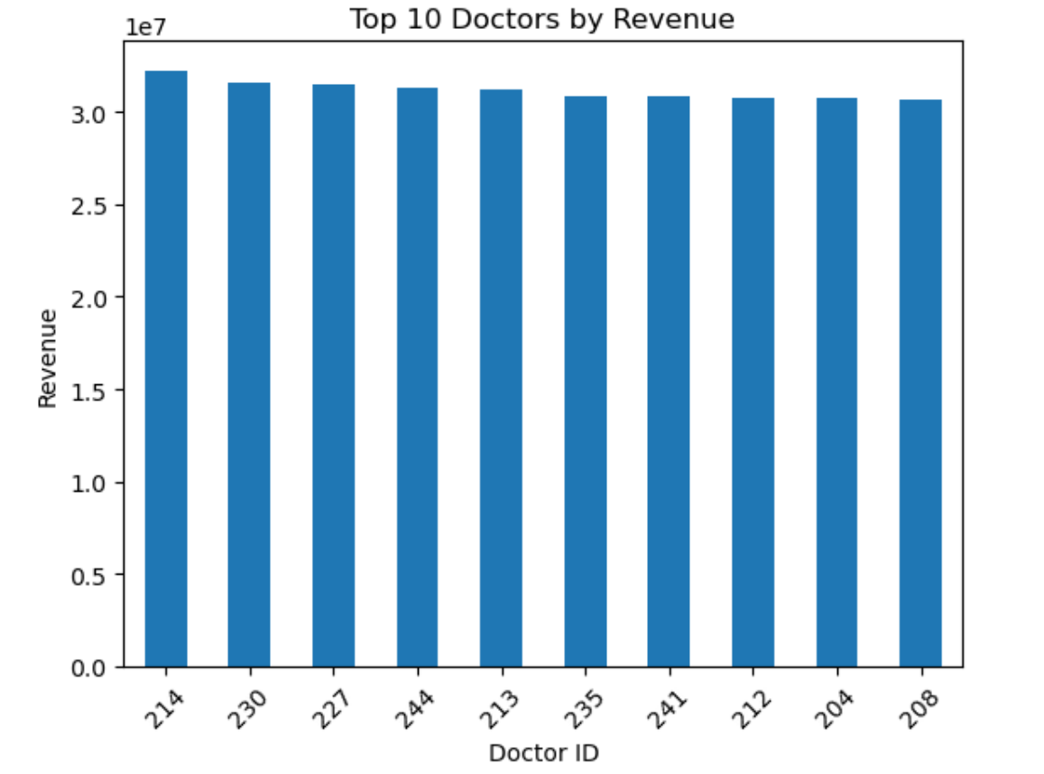
3.Admission Trends (Monthly)
(Seasonal pattern)
4. Doctor Performance
Few Doctors handle majority of cases

Slide 11
Recommendations
Increase resource allocation to high-revenue departments
Improve efficiency in long-stay departments
Balance workload among doctors
Optimize insurance policies for better revenue recovery
Prepare staffing based on seasonal admission trends

Slide 12
Conclusion
Successfully cleaned and transformed raw hospital data
Built meaningful features for analysis
Extracted business insights for decision-making
Project demonstrates end-to-end data analytics pipeline

